Slide 1
CBM Spring 2014
Dr. Hao Peng
Pav. E.3
h.peng@tue.nl

Slide 2
Lectures’ subjects
22 May: 8:45-10:30 (LaPlace Building 1.19)
  Delay Time Model
5 June: 8:45-10:30 (LaPlace Building 1.19)
  Degradation Model
  Source: lecture note

Slide 3

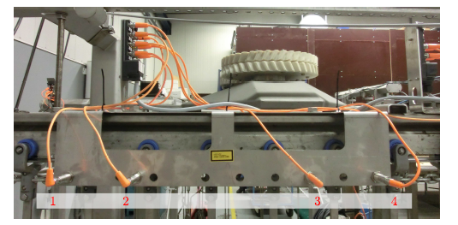
Why do we use condition-based maintenance?
Notes:
1, dimension, strength, smoothness of rubbing surfaces
2, oxide thickness
3, fill volumn
4. Blood pressure
5, percentage of ingredients

Slide 4
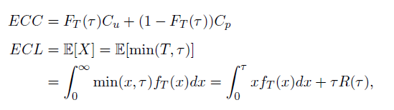
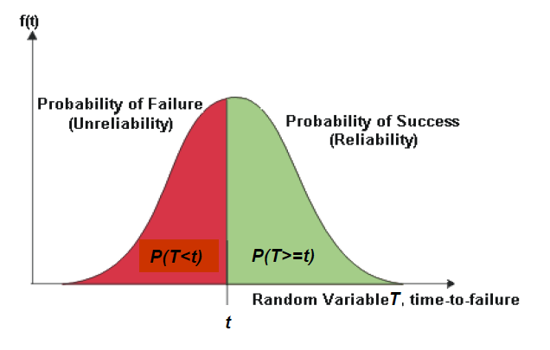
Age-based
What is the major difference between CBM and other age/time based policies?
Age/time based policies: failure time distribution

Slide 5
System states
What is the assumption behind the random failure time T?
Two states: normal, failure
  Electronic devices (short circuits), structure failure
For CBM, there are multiple intermediate states.
Three states: normal, defective, failure
Multiple discrete states: newest (initial), deterioration states, failure
Continuous state: newest (initial), deterioration state, failure
Notes:
Let’s first look at three state case.

Slide 6
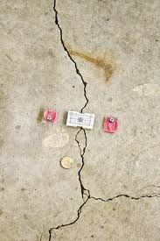
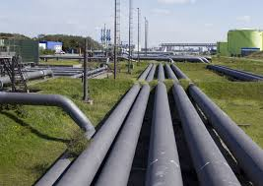
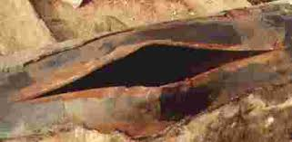
Three states (crack)
Normal
Defects
Failure

Slide 7
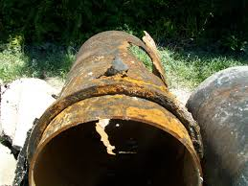
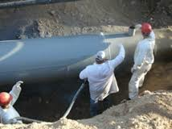
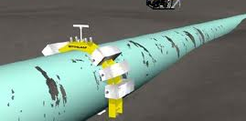
Three states (corrosion)
Normal
Defects
Failure
How to describe this three states failure process?

Slide 8
Three states (delay time model)
Normal
Defects
Failure
Normal state: works fine, no defects
Defective state: works fine, defects appear, can only be detected by inspections
Failure state: self-announcing, stop working
How shall we schedule the maintenance?
How can we schedule inspections to identify the defects before failure?

Slide 9
Periodic inspection policy
Inspect the system every tau time units till failure or defect state
Normal
Defects
Failure
Normal
Defects
Failure

Slide 10
Periodic inspection policy (a special case)
If the time to defect follows an exponential distribution, what are the renewal events?
  Inspection at normal state
  Inspection at defective state
  Failure renewal
What are the probabilities of these renewal events at the end of a renewal cycle?

Slide 11
Periodic inspection policy (a special case)
Numerical example
X~exponential (lambda=0.6)
H~exponential (lambda=0.75)
Ccm=1000
Cpm=150
Ci=15
Probabilities of the renewal events?
Numerical calculation is not required for the exam.

Slide 12
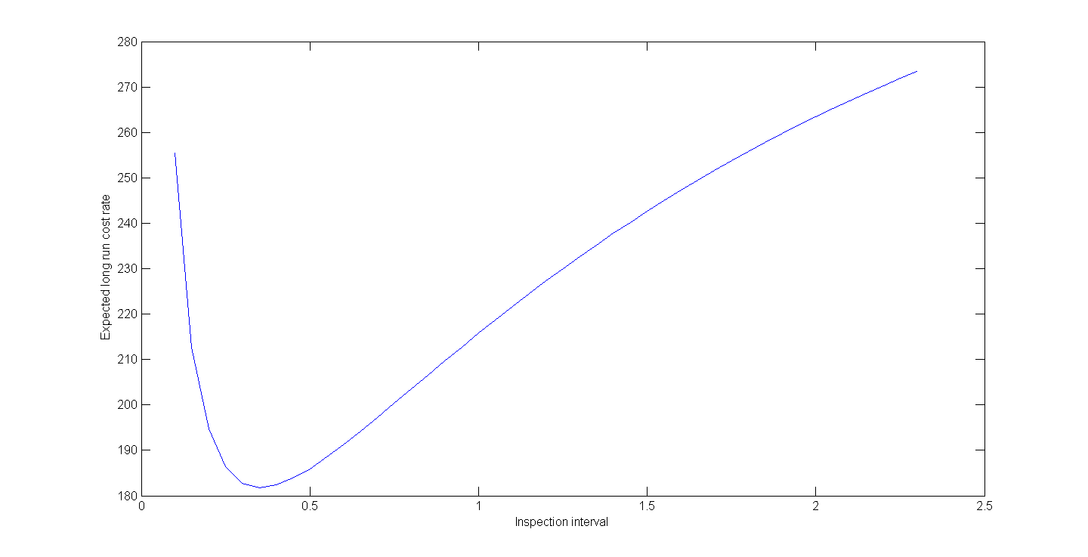
Periodic inspection policy (a special case)

Slide 13
Periodic inspection policy (a general case)
If the time to defect does not follow an exponential distribution, what are the renewal events?
  Inspection at defective state
  Failure renewal
What are the probabilities of these renewal events at the end of a renewal cycle?

Slide 14
Periodic inspection policy (a general case)
Numerical example
X~Weibull(beta=2, eta=0.6)
H~Weibull(beta=2,eta=0.75)
Ccm=1000
Cpm=150
Ci=15
Probabilities of the renewal events?
Numerical calculation is not required for the exam.

Slide 15
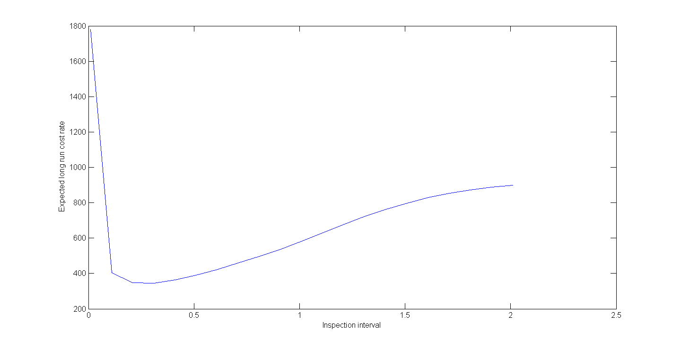
Periodic inspection policy (a general case)

Slide 16
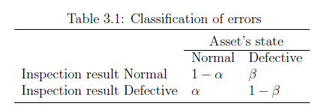
A master project at Nedtrain
What if the inspections are imperfect?

Slide 17
Estimation
Expert information (failure mechanism)
  Surveys, questionnaires
Lab testing (failure data ,defects at inspections)
Field data (failure data, defects at inspections)
  Notice that these data points can be censored data
  maximum likelihood estimator can be used

